Slide 1

Can you Scare People Green?
Denise Baden, Professor of Sustainable Practice.
University of Southampton SF 2026 Feb 2026

Slide 2
Outline of session
Stories: news, education, fiction, plays, TV, marketing
Positive role models vs cautionary tales
Psychological Theories
Moving beyond preaching to the converted: hairdressers
Green Stories Project
Habitat Man/The Assassin/No More Fairy Tales: Stories to Save Our Planet
BAFTA #ClimateCharacters
Thrutopian approach

Slide 3
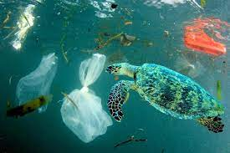
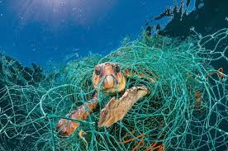
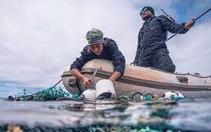
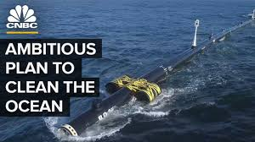
News stories: Which is more effective – positive or negative news?
News story on how plastic is killing animals in our oceans
News story on a project to clean up plastic in oceans

Slide 4
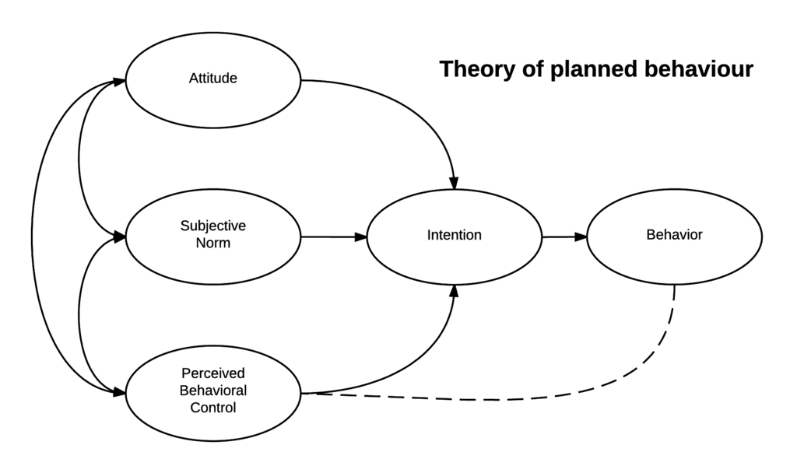
Theory of Planned Behaviour (Ajzen, 1991)

Slide 5
Stories in education: Positive role models vs cautionary tales
Business ethics students exposed to positive role models of sustainable businesses or ethics scandals.
Positive role models more likely to lead to ethical intentions
Cognitive science research supports the important role of role models as they tap into the way in which our brain processes information and learns:
“The exemplar theory suggests, however, that what moral learning consists in may not be (primarily) the learning of rules but the acquisition of pertinent exemplars or examples…. A morally suitable role model may be didactically more effective than a set of behavioural maxims” (Goldman 1993: 341) .

Slide 6
Climate fiction: Research into responses to short stories with a green theme
Responses to short stories with a solution focus:
  The positive stories were inspiring and made me realise everyone can make a difference.
  I think the ones with solutions have more impact than the over the top scare mongering.
  The second story felt inspirational. It gave me a simple option that I could take to do something positive for the environment.
  I felt inspired by the way the characters behaved. Made me think about what I could do.
Responses to short stories with a catastrophic focus:
  This was very frightening and negative. It made me angry and I switched off.
  I turned off a bit, because I felt a flood in housing was common and realistic in the news every year now, and I'd rather not think about it.
  We- the little person - are powerless.
  Scaring people only leads to switching off.

Slide 7
4 Common mistakes
Focusing on raising awareness – doesn’t always lead to behaviour change, or the kind of change you hope for
Focusing on problems not solutions
Preaching to the converted
Not knowing your facts – many so-called climate solutions are either greenwashing or solve on problem by creating another e.g. ‘sustainable’ palm oil.

Slide 8
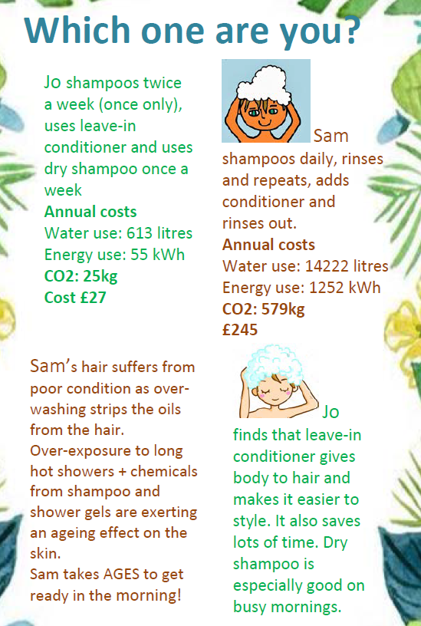
www.ecohairandbeauty.com
I use mini character portraits to capture key points.
Promotes benefits of water/energy saving products such as dry shampoo in terms of benefits to user.

Slide 9
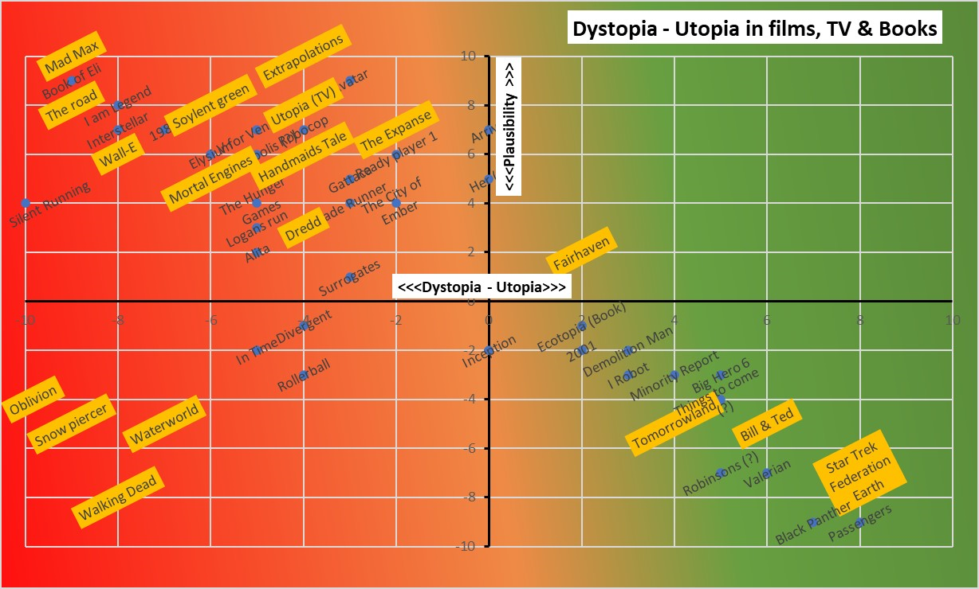

Slide 10
Need to move from top left quadrant to bottom right quadrant
 | Low agency | High agency
High eco-anxiety | Pointless fretting, passive despair, nightmares, pessimism. Risk of alienating others | Driven action at expense of mental health, risk of burnout and aliening others
Low eco-anxiety | Lack of awareness, avoidance. If not part of solution then part of problem. Mindless complicity. | Calm, effective action.

Slide 11
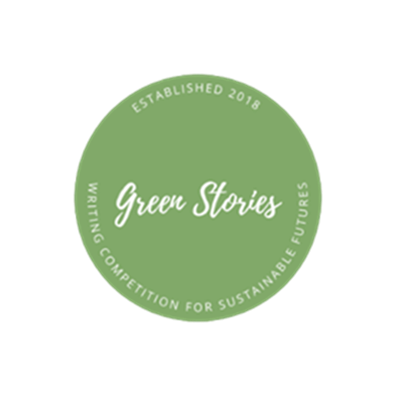
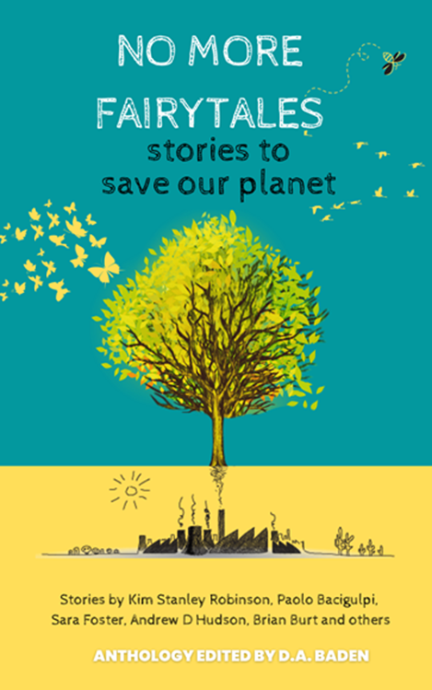
Green Stories Project
Ask writers to check out transformative solutions on http://www.greenstories.org.uk and integrate them into their story.
Since 2018 we have run 21 free competitions across several formats: stage play, novel, children’s book, short stories, flash fiction, interactive fiction, radio play, screen play etc.!
  www.greenstories.org.uk
  FB/insta greenstoriessoton
  https://bsky.app/profile/greenstories.bsky.social
  Email greenstories@soton.ac.uk

Slide 12
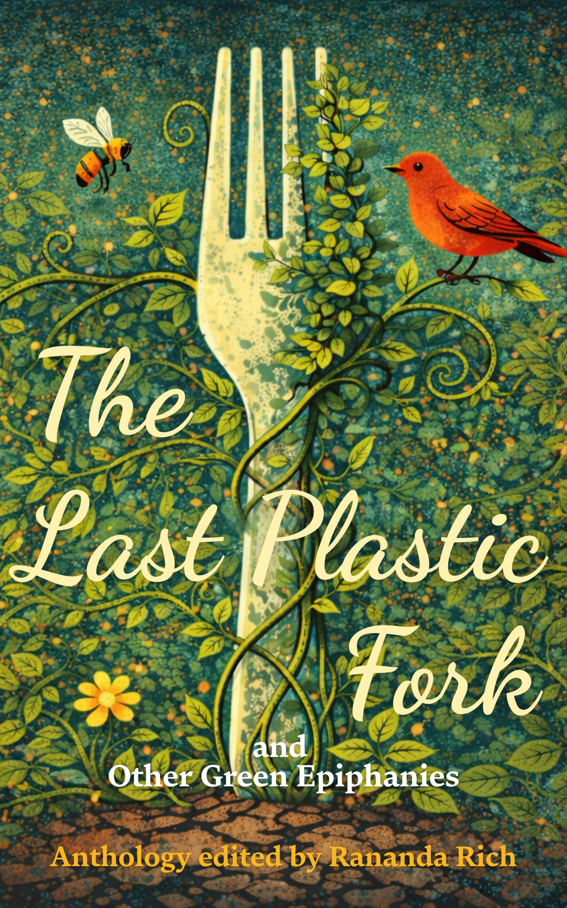
Green Stories Project
2026: Epiphany anthology and short film competition
PUBLICATION 26th FEBRUARY 2026
(Pre-order available!)
The Last Plastic Fork invites you into a universe of transformations. Every tale in this short story collection explores a moment of revelatory change, ranging through a dazzling variety of topics, styles and genres. Do bees like raving? What do trash and exes have in common? And is hot husband compost the next step in effective garden management?

Slide 13
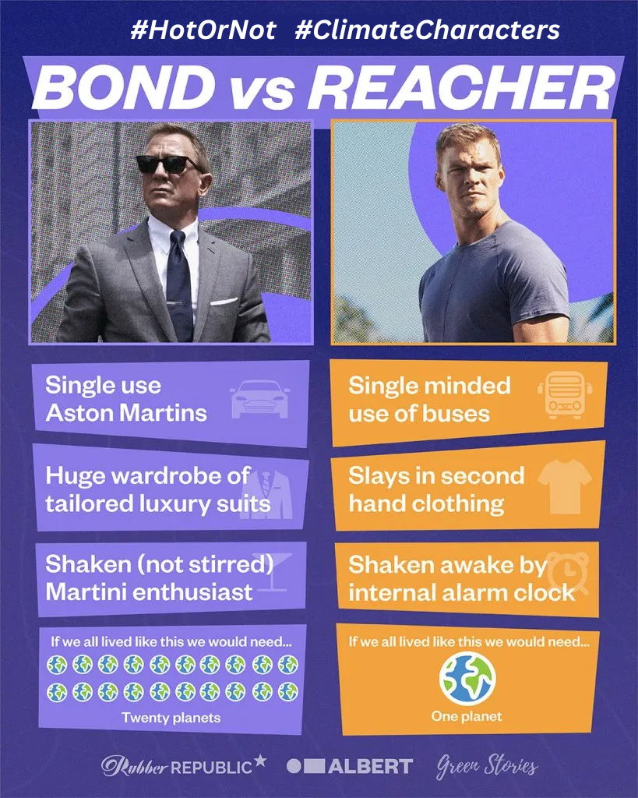
#ClimateCharacters
Link to a survey on how fictional characters affects aspirations and behaviour.
Most accept it probably affects attitudes and behaviours on a subconscious level.
‘I do believe this matters as on a subconscious level it could be affecting how we behave and live in real life, which has a real impact on the environment’.
Most think scriptwriters should consider this when writing characters.
‘TV and film should not normalise and glamourise high carbon lifestyles’.

Slide 14
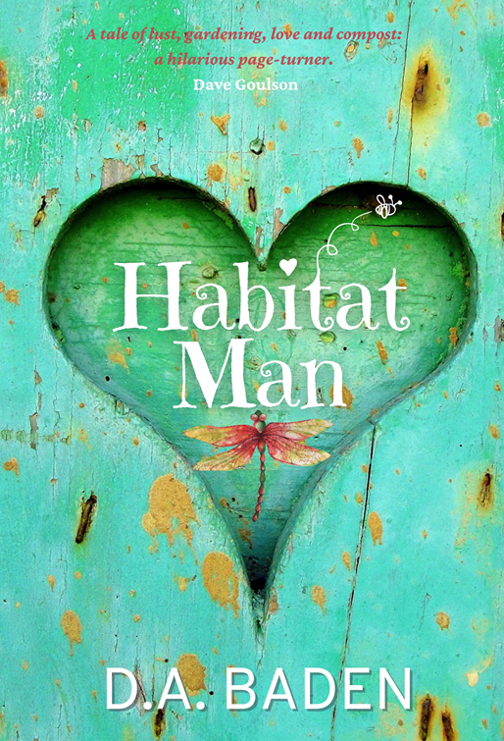
Using a rom-com to reach a wider audience: Habitat Man
Rom-com about a man who gives up his city job to help people make gardens wildlife-friendly. In the process, he falls in love and digs up a body.
Research of 50 readers shows 98% adopted at least one green alternative.
Wildlife gardening, natural burials, composting toilets, low-carbon food, joined pesticide action network etc.
“Yes, I have cut food waste to virtually zero. I no longer buy pre packaged foods and have now started to grow a lot of fruit and vegetables”.
“It made me think about what I will do when I move into my next house with a garden, I'd initially thought that I'd pave it but now I'm thinking about making it more animal friendly”.

Slide 15
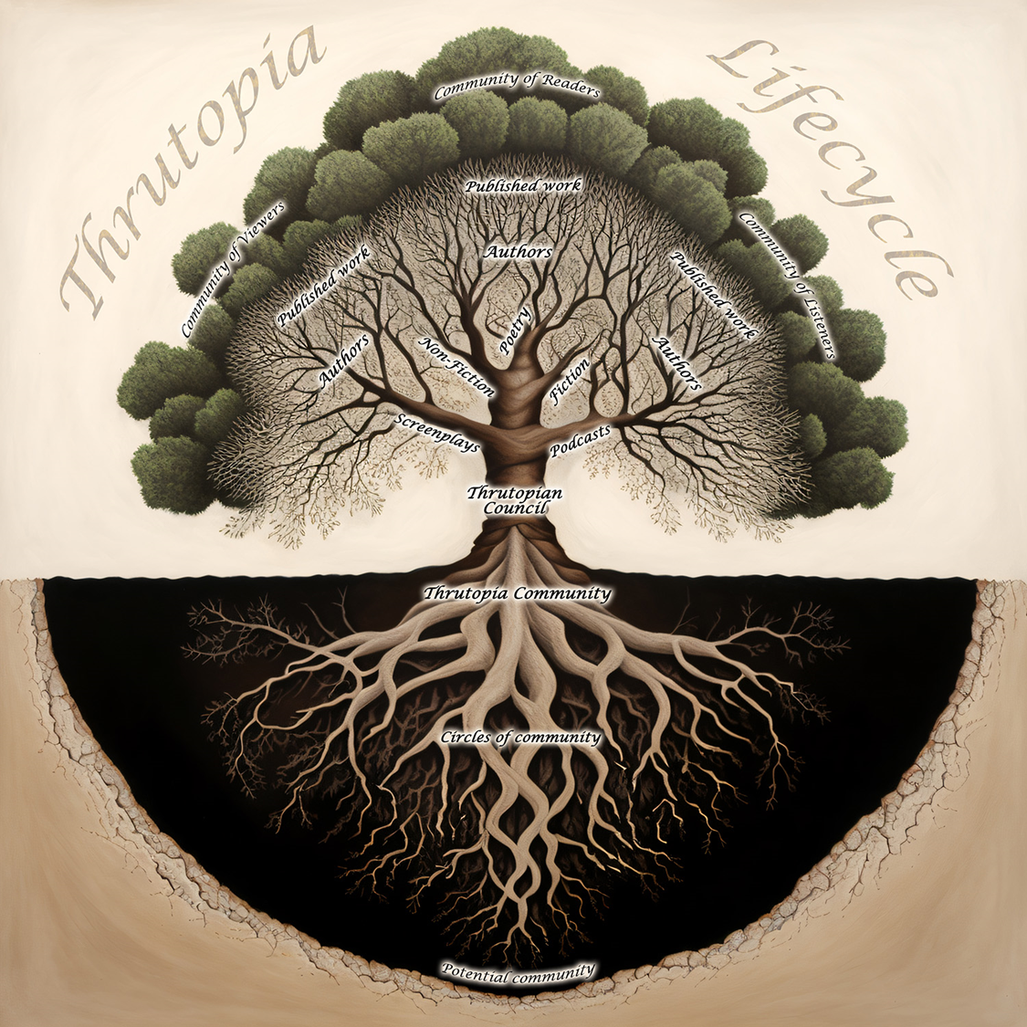
Thrutopian approach
Imagine what a sustainable society would look like, then work backwards to see how we might get there.

Slide 16
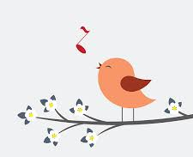
Exercise 1 ‘From what is to what if’ the power of visioning a future we’d love to live in (Rob Hopkins)
Shut your eyes – take two minutes.
Bypass your rational mind and with your heart and soul - dream
Imagine it is ten years in the future. The world has done an about turn and is exactly as you’d love it to be.
Walk through your transformed neighbourhood.
What do you see, hear, smell? How do you feel?
What are other people doing?

Slide 17
Exercise 2. Now think with your head: 3 minutes
What kind of polices/practices might have got us there?
Encourages us to think in terms of systems thinking and what leads to what.
Change requires government policies. These require:
  Public support (culture, knowledge, proper incentives).
  Business support (e.g. align low-carbon practices with financial incentives)
  Good governance – upgrade democratic systems to promote longer term thinking.
  Changes in values and norms
Fiction creates a safe space to imagine how we might do things better.

Slide 18

Eight people in a citizen’s jury, discussing the most important challenge in the history of humanity – how to save ourselves from the climate crisis.
Exciting new solutions are proposed, each with their own champions and detractors. What they decide will affect us all.
But they all have their own issues to deal with, and what is more, one of them has a hidden agenda. Who is the assassin and who are they there to kill?
Adapted as an interactive play: audience vote on climate solutions: https://www.dabaden.com/murder-in-the-citizens-jury/.
https://youtu.be/qlLfNsCUQys

Slide 19
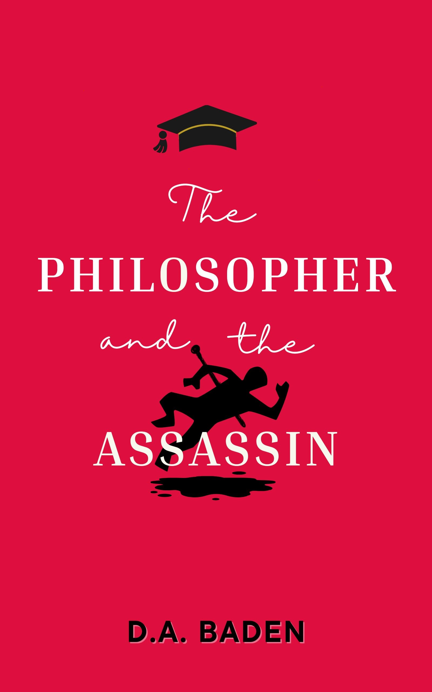
Campus novel/Philosophy/whodunnit
A fusion of campus novel and whodunnit. The protagonist is Iris Tate, professor of moral philosophy. When the Dean proposes the controversial concept of ‘edutainment,’ Iris devises a course based on a whodunnit that all assume is hypothetical – a murder in a climate assembly. A variety of characters provide an entertaining source of ethical dilemmas, and all relate to the proposed climate policies in different ways. But what the students don’t know is that the ultimate dilemma is very real.
https://www.dabaden.com/

Slide 20
Summary – avoid the 3 Common mistakes
Focus on agency, showing solutions, role-models, examples of success.
Find innovative ways to engage those outside the climate echo chamber.
Understand what works and what is a ‘pretend’ solution.

Slide 21
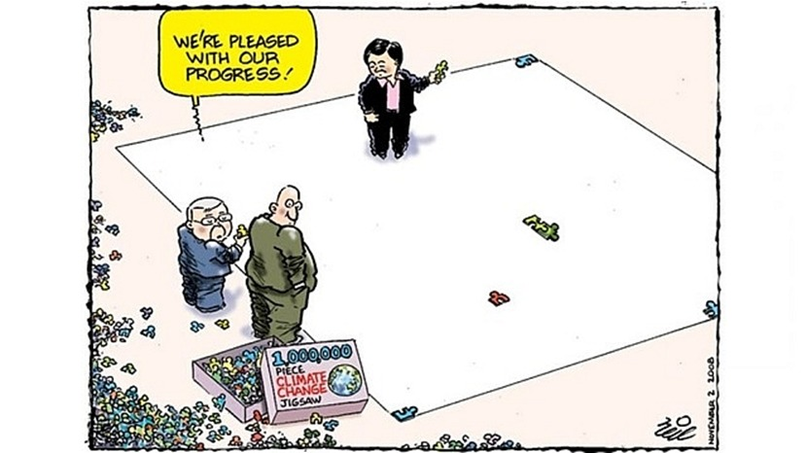
A Jigsaw to Save the World

Slide 22
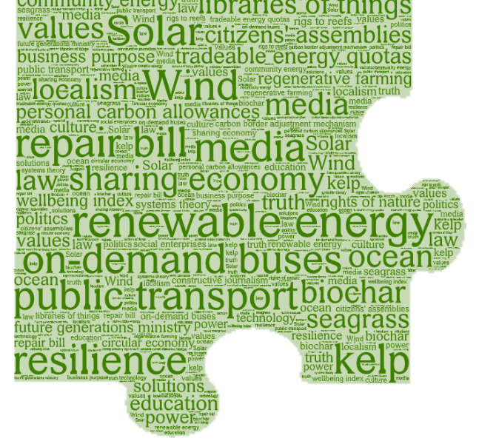
A Jigsaw to Save the World
This is a fortnightly LinkedIn newsletter:
https://www.linkedin.com/newsletters/a-jigsaw-to-save-the-world-7300475505529540608/
This will be written up as a book and produced also as an actual jigsaw: see https://www.dabaden.com/a-20-piece-jigsaw-to-save-the-world/

Slide 23
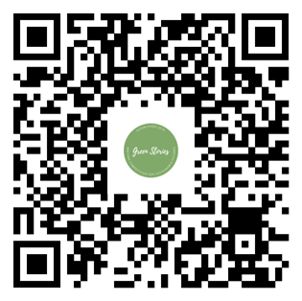
Feel free to connect
Website: www.dabaden.com
Email: D.A.Baden@soton.c.uk
X: @DABadenauthor @dabaden.bsky.social
linkedin.com/in/denise-baden-3742793
Creative Climate Communication newsletter on Linked-In
Habitat Man and No More Fairy Tales: Stories to Save our Planet, and The Philosopher and the Assassin are available as an eBook or paperback or audio (HM).
Play: Murder in the Citizens’ Jury is available on Lazybee or royalty-free for amdram/student theatre companies to put on (if you come direct)

Slide 24
Booktokker needed
If you love fiction and the environment and
would like to help, we have some YA novels we’d love to get in front of BookTok audience
Contact me if interested
D.A.Baden@soton.ac.uk

Slide 25
